Slide 1
Interesting figures we can use

Slide 2
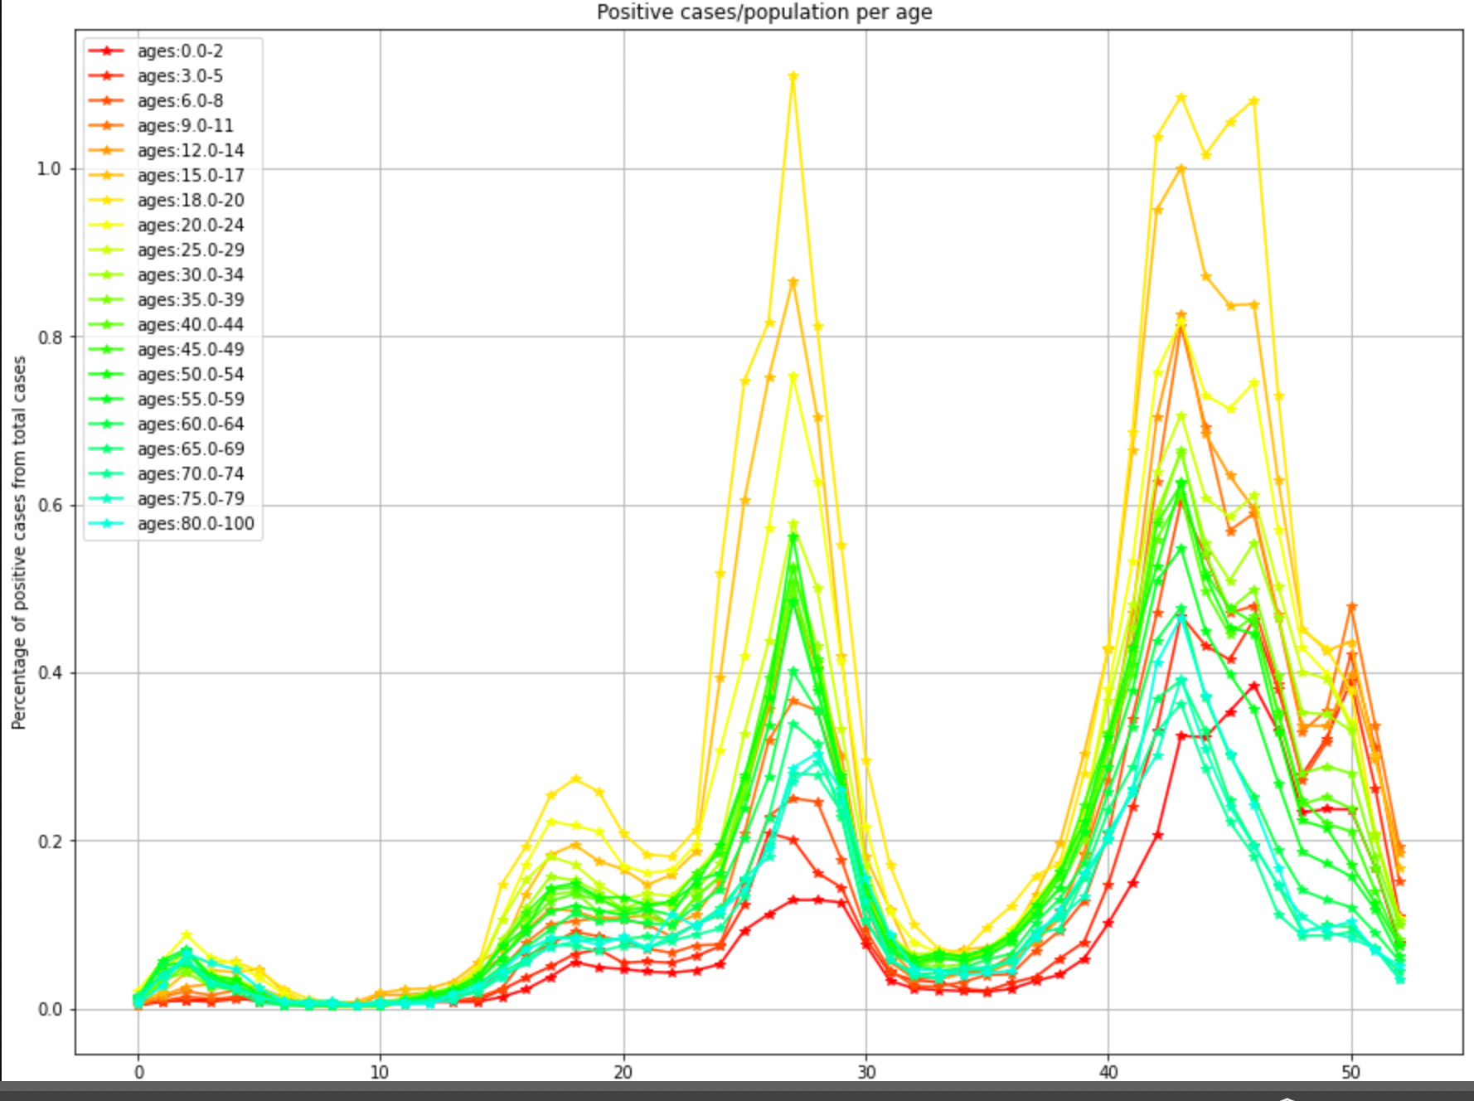
Number of positive / population all ages

Slide 3
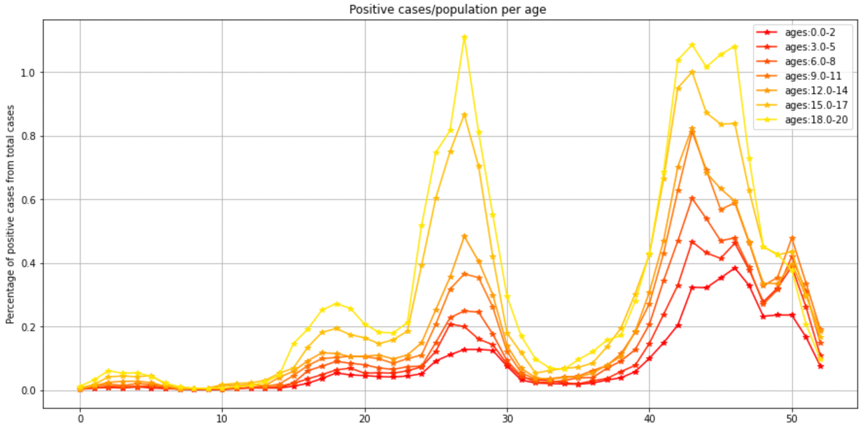
Number of positive / population – young

Slide 4
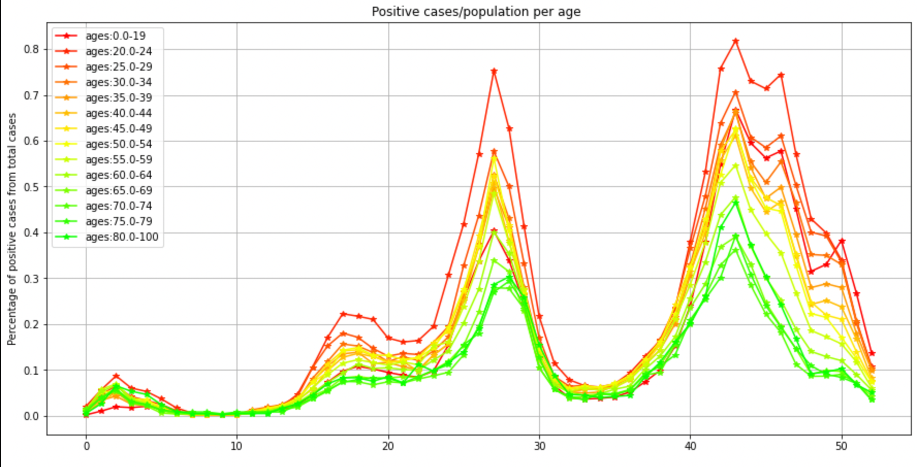
Number of positive / population – adults

Slide 5
Percentage positive tests – england (since vaccinations started)
https://www.ons.gov.uk/peoplepopulationandcommunity/healthandsocialcare/conditionsanddiseases/articles/coronaviruscovid19roundup/2020-03-26

